Slide 1
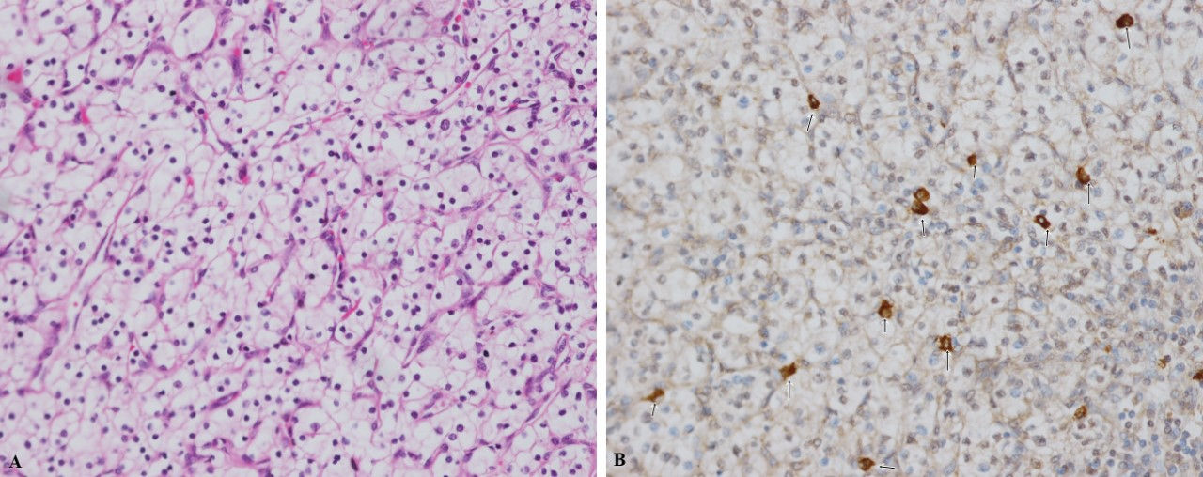
CAN CXCL13 BE A PROGNOSTIC MARKER IN CLEAR CELL RENAL CELL CARCINOMA?
Esma Sayar ¹, Ganime Çoban²
¹ Bezmialem Vakıf University, Faculty of Medicine , Istanbul ,Turkey
² Bezmialem Vakıf University, Faculty of Medicine, Department of Pathology, Istanbul, Turkey
INTRODUCTION
RESULTS
Renal cell cancers are a heterogeneous group of cancers arising from renal tubular epithelial cells and the most common subtype is clear cell renal cell cancer (ccRCC) (1). CXCL13, a B-cell chemoattractant, is a chemokine belonging to the CXC family that has been associated with a variety of autoimmune, infectious, lymphoproliferative diseases and malignancies (2). Studies in clear cell renal cell carcinoma indicate that CXCL13 increases cancer proliferation and migration and CXCL13 may be a prognostic marker in clear cell renal cell carcinomas. (3,4).
The aim of our study is to evaluate the immunohistochemical staining patterns of CXCL13 in clear cell renal cell carcinomas and to determine its relationship with pathological tumor stage, risk factors and prognostic parameters.
In terms of intratumoral lymphocyte staining, the rate of high staining was higher in T3 stage tumors than T1 stage (p = 0.05). Non-smoking cases were mostly in the low staining group (p = 0.06). There were 5 cases with lymph node metastasis and all of them were in the low staining group (p = 0.05). Low stained lymphocytes in the kidney with CXCL13 were higher in all T stages. T3 stage tumors were less than T1 stage in those with low staining (p= 0,04).
MATERIALS AND METHODS
100 patients who underwent partial / radical nephrectomy and diagnosed with clear cell renal cell carcinoma between 2012 and 2019 were included in our study. The demographic and clinicopathological data of our patients are shown in the table.
 | T1(41) | T2(18) | T3(40)
AGE | 54,59± 13,89 | 52,77±12,17 | 58,4±12,05
GENDER(M/F) | 27/14 | 9/9 | 33/8
SMOKING | 12 | 4 | 10
HYPERTENSION | 22 | 8 | 20
TUMOR DIAMETER | 4,05±1,37 | 9,92±3,35 | 8,34±2,72
NUCLEAR GRADE 1 2 3 4 | 1 26 14 - | 1 6 8 3 | - 11 21 8
PERIRENAL INVASION | - | - | 22
PELVIS INVASION | - | - | 29
LYMPH NODE METASTASIS | - | - | 5
DISTANT METASTASIS | 1 | 1 | 13
Figure: A. Clear-cell renal cell carcinoma (H & E, x200) B. Presence of CXCL13-positive colored lymphocytes in the tumor (arrow) (x200)
 | ALL PAINTED WITH CXCL13 | LOW PAINTED WITH CXCL13 | HIGH PAINTED WITH CXCL13 | P VALUE
AGE | 58.03± 13,7 | 54,54 ± 13,7 | 57,69 ± 12,47 | 0,24
T STAGE T1 T2 T3 T4 | 41 18 40 - | 28 12 17 - | 13 6 23 - | 0,05
WHO ISUP NUCLEAR GRADE 1 2 3 4 | 2 42 44 11 | 1 25 26 5 | 1 17 18 6 | 0,87
TUMOR DIAMETER | 6,6 (1,7-20,0) | 6,0 (1,7- 20,0) | 7,5 (2,5-14,0) | 0,44
NODE METASTASIS N0 N1 | 91 5 | 51 5 | 40 0 | 0,05
DISTANT METASTASIS M0 M1 | 78 16 | 45 10 | 33 6 | 0,72
SMOKING YES NO | 26 64 | 11 41 | 15 23 | 0,06
HYPERTENSION YES NO | 51 43 | 30 23 | 21 20 | 0,60
Table:The demographic and clinicopathological data of patients
CXCL13 antibody was stained immunohistochemically on Ventana Benchmark Ultra device by taking 4 micron sections from paraffin blocks.
During microscopic examination, CXCL13 positive stained cells in 10 high magnification fields were counted
Cells stained with CXCL13 were evaluated using a semi-quantitative H score: 3 × strongly stained + 2 × moderately stained + weakly stained. The cut-off value was set as 40 for values between 0-300
The low and high stained groups were compared with pathological tumor stage, WHO ISUP nuclear grade, tumor diameter, lymph node metastasis, distant metastasis , smoking and hypertension.
Table:Comparison of CXCL13 with high and low staining intratumoral lymphocytes in terms of pathological prognostic parameters and risk factors
DISCUSSION
CXCL13 has been studied in many cancer types such as prostate and breast, but studies in kidney cancers are limited (2). Current studies suggest that intratumoral CXCL13 expression is associated with a poor prognosis in kidney cancers. (3,4). In our study, although there is no statistically significant difference between staining and other prognostic parameters, the relationship we found between advanced pathological stage and high intratumoral CXCL13 staining (p=0,05) suggests that CXCL13 has a prognostic value in clear cell renal cell carcinomas.
REFERENCES
Diagram:Methods
Hsieh JJ, Purdue MP, Signoretti S, Swanton C, Albiges L, Schmidinger M, Heng DY, Larkin J, Ficarra V. Renal cell carcinoma. Nat Rev Dis Primers. 2017 Mar 9;3:17009
Hussain M, Adah D, Tariq M, Lu Y, Zhang J, Liu J. CXCL13/CXCR5 signaling axis in cancer. Life Sci. 2019 Jun 15;227:175-186.
Zheng Z, Cai Y, Chen H, Chen Z, Zhu D, Zhong Q, Xie W. CXCL13/CXCR5 Axis Predicts Poor Prognosis and Promotes Progression Through PI3K/AKT/mTOR Pathway in Clear Cell Renal Cell Carcinoma. Front Oncol. 2019 Jan 22;8:682.
Jiao F, Sun H, Yang Q, Sun H, Wang Z, Liu M, Chen J. Association of CXCL13 and Immune Cell Infiltration Signature in Clear Cell Renal Cell Carcinoma. Int J Med Sci. 2020 Jun 27;17(11):1610-1624.

